Slide 1
Domain Name System Forensics

Slide 2
Domain Name System (DNS)
Domain
(google.com)
Motivation: Every device is identified by an IP address, which is a unique numerical identifier.
Problem: However, IP addresses are numbers and can be difficult for people to remember and use.
Solution
Each device has a human-readable string (domain name). Each domain name corresponds to an IP address
DNS translates domain names into IP addresses and vice versa.
DNS
IP
(216.58.194.174)
Notes:
https://kinsta.com/knowledgebase/what-is-dns/

Slide 3
DNS like a phone book for the internet
Just like how you can look up your friend's phone number in a phone book to call them
your computer or tablet uses DNS to look up the address of a website you want to visit on the internet.
When you type in the name of a website like YouTube
your computer or tablet sends a message to a special computer called a DNS server.
The DNS server looks up the address of YouTube and sends it back to your computer or tablet.
Then, your computer or tablet uses that address to find YouTube and show you all your favorite videos!
So, the next time you use the internet, remember that DNS is working behind the scenes to make it all possible!

Slide 4
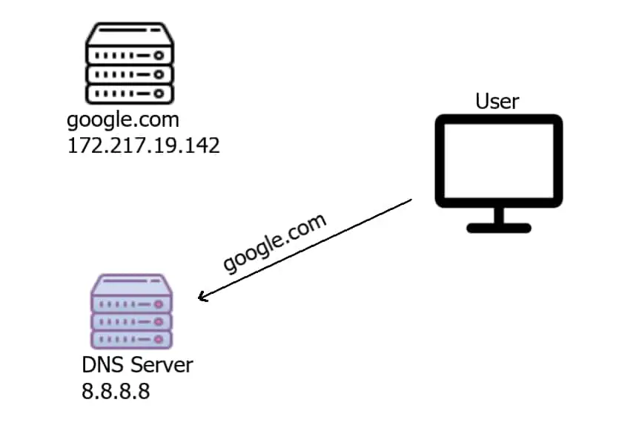
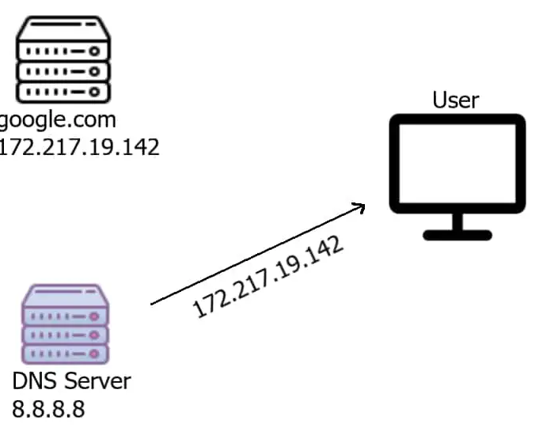
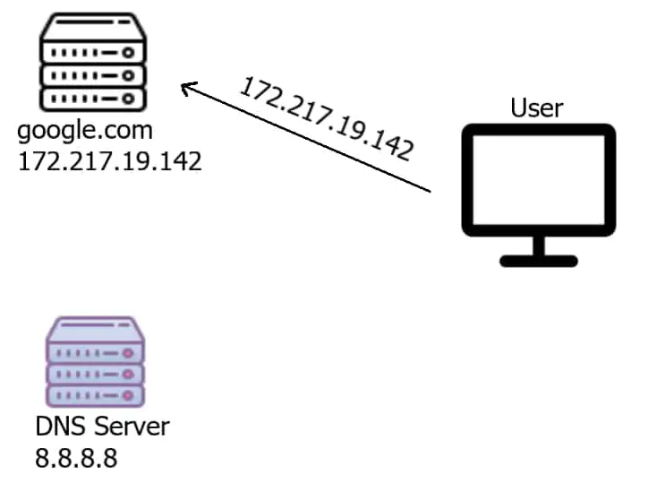
1. What is the IP of google.com?
2. Here is the IP of google.com
3. Now User can talk to google.com
Notes:
https://www.thepythoncode.com/article/make-dns-spoof-python

Slide 5
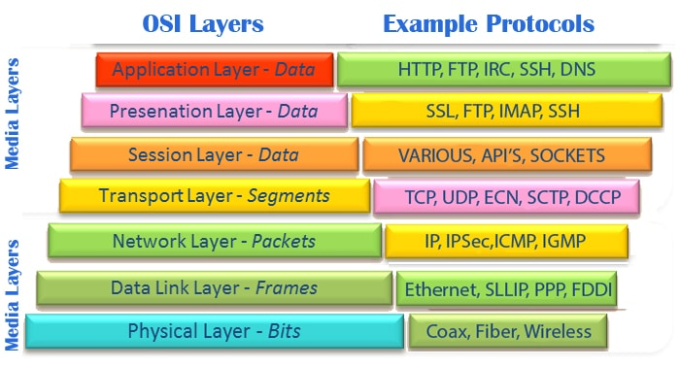
https://asmed.com/comptia-network-osi-model/

Slide 6
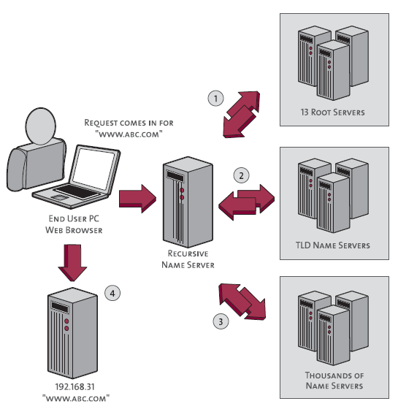
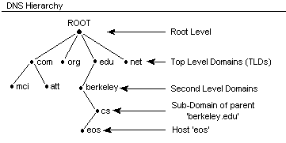
DNS is a hierarchical naming system
https://www.inetdaemon.com/tutorials/internet/dns/operation/hierarchy.shtml
https://www.pingdom.com/blog/a-visual-explanation-of-how-dns-lookups-work/

Slide 7
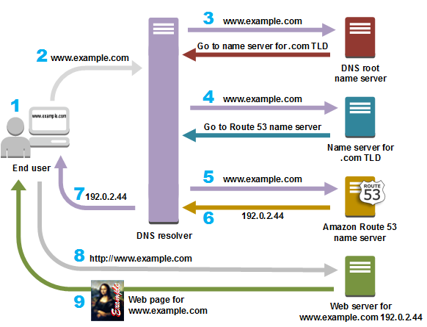
DNS Example
DNS resolver is often managed by the user's Internet service provide
TLD: top-level domain, such .com, org
https://aws.amazon.com/route53/what-is-dns/

Slide 8
Observe DNS with dig

Slide 9
dig
It is a network administration tool used in Linux and other Unix-based operating systems to perform DNS (Domain Name System) queries.
retrieve information about DNS records, including
IP addresses associated with domain names,
mail server information, and
other DNS-related information.
It sends a query to a specified DNS server and returns the response in a human-readable format.
It can be used to troubleshoot DNS issues, test DNS configuration changes, and gather information about DNS servers.

Slide 10
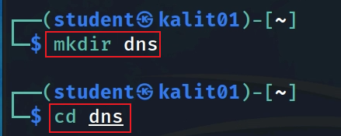
Create a working directory

Slide 11
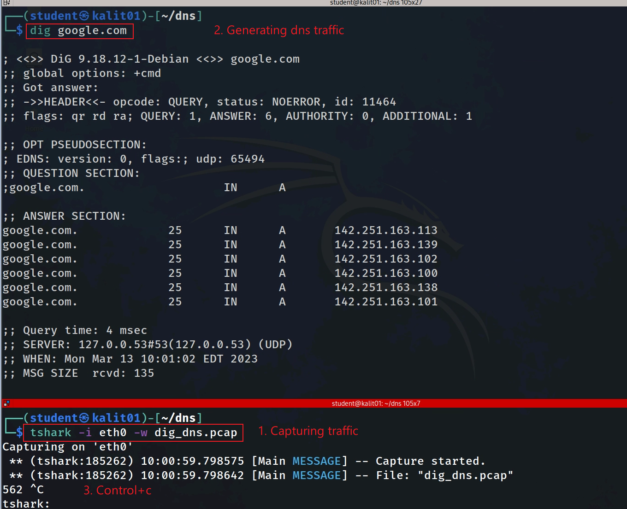
Notes:
tshark -i eth0 -w dig_dns.pcap

Slide 12
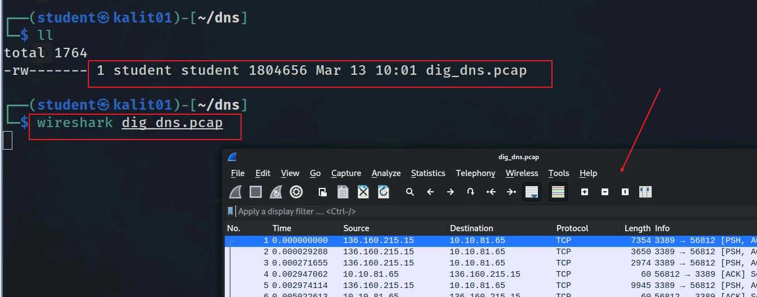

View captured DNS traffic
wget https://raw.githubusercontent.com/frankwxu/digital-forensics-lab/main/Networking_Forensics/lab_files/dns/dig_dns.pcap

Slide 13
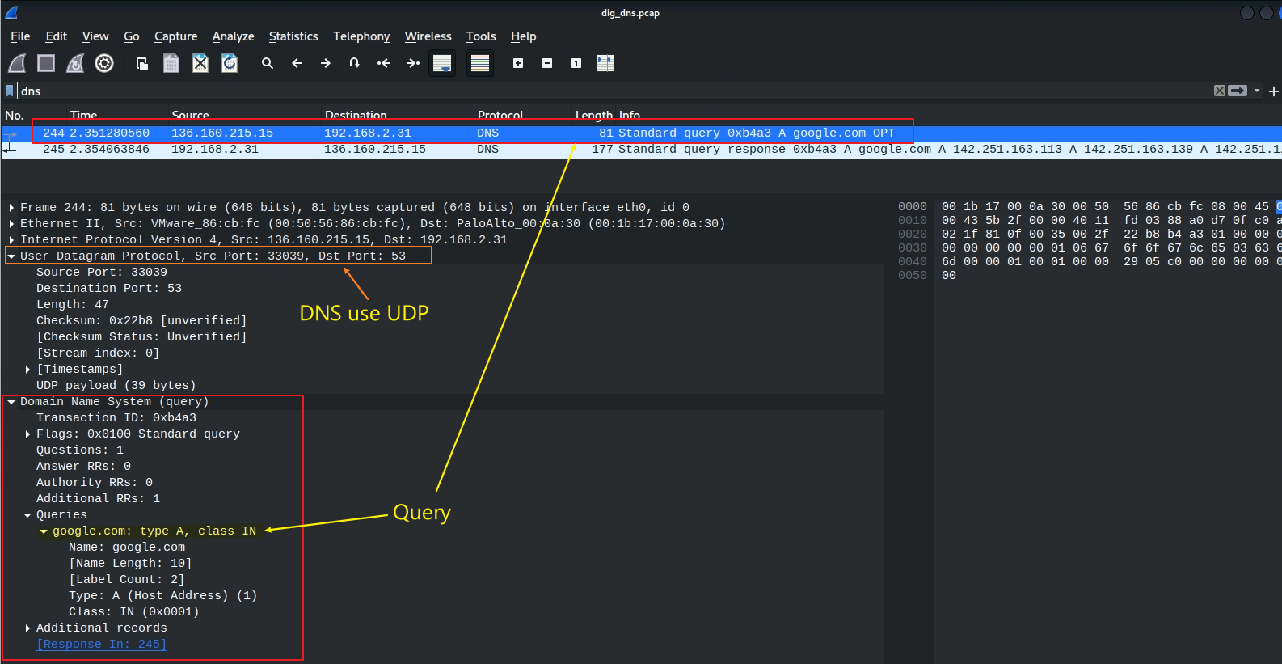
View layers DNS/UDP/IP/Frame of DNS query
dns filter

Slide 14
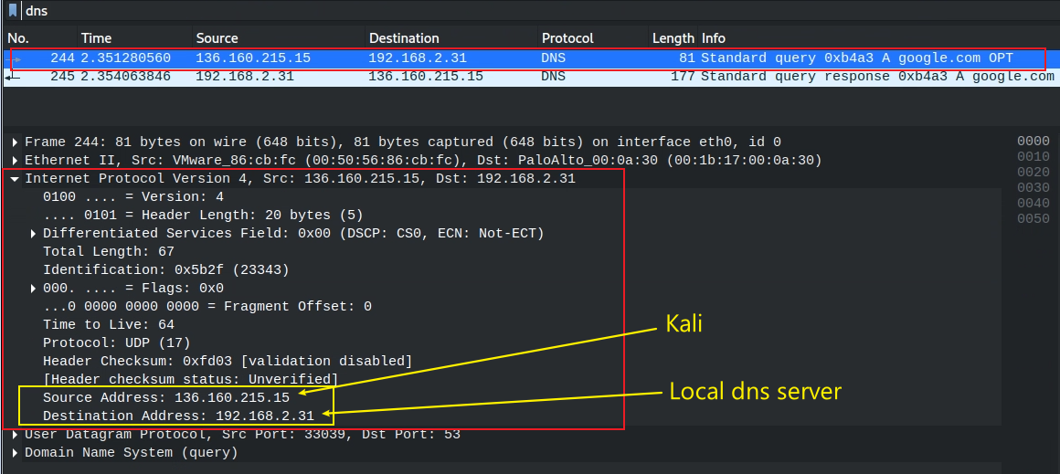
View DNS query source and destination IPs

Slide 15
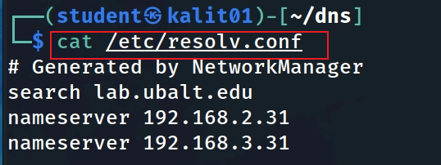
Local DNS configuration file
lists the DNS servers that your system is using for name resolution.
match DNS traffic

Slide 16
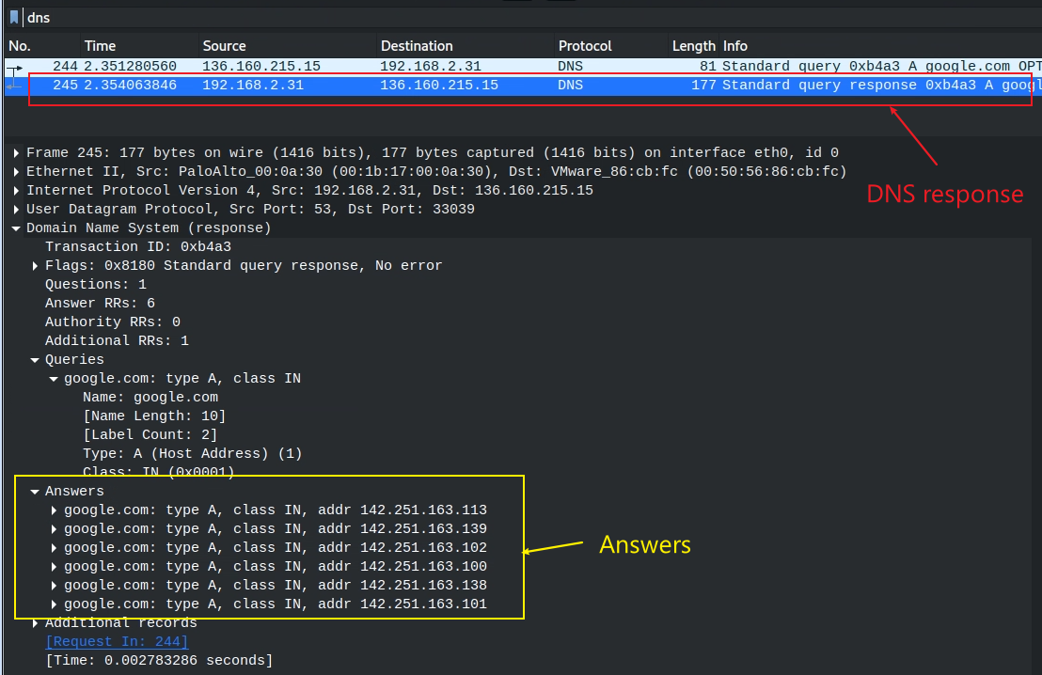
DNS response

Slide 17
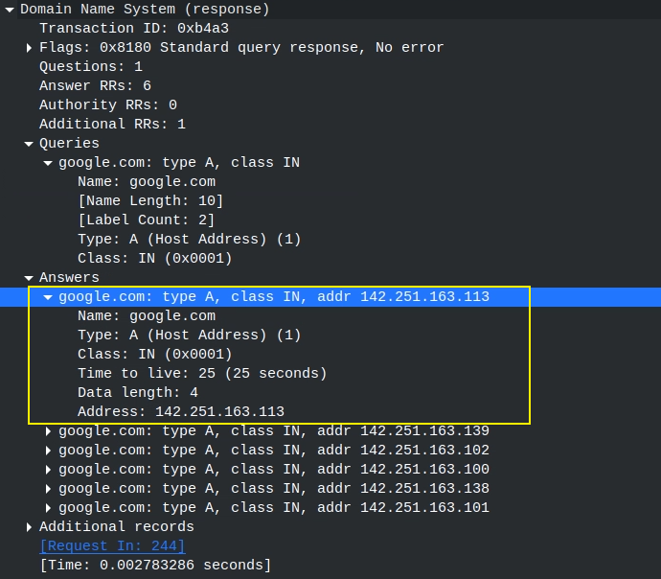
One of answers
maps the domain name to an IP address.
refers to the Internet class.

Slide 18
Observe the DNS traffic of accessing google.com

Slide 19
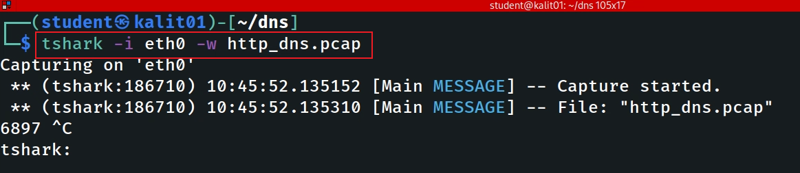
Command to capture traffic
Notes:
tshark -i eth0 -w http_dns.pcap

Slide 20
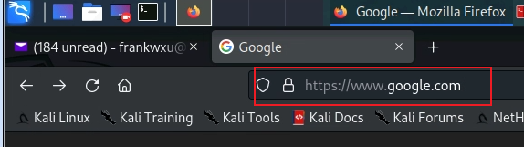
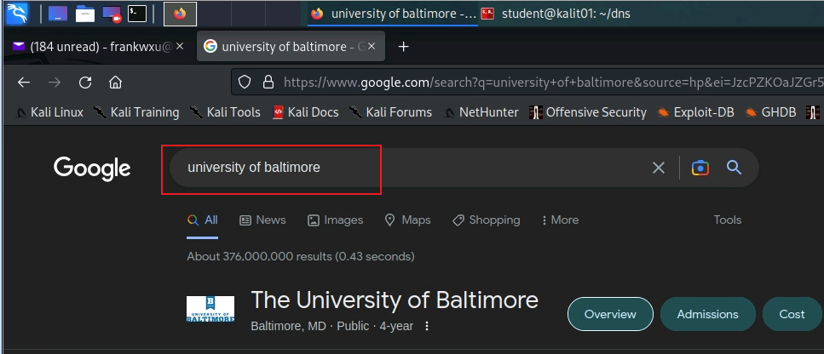
Accessing google.com and google search

Slide 21
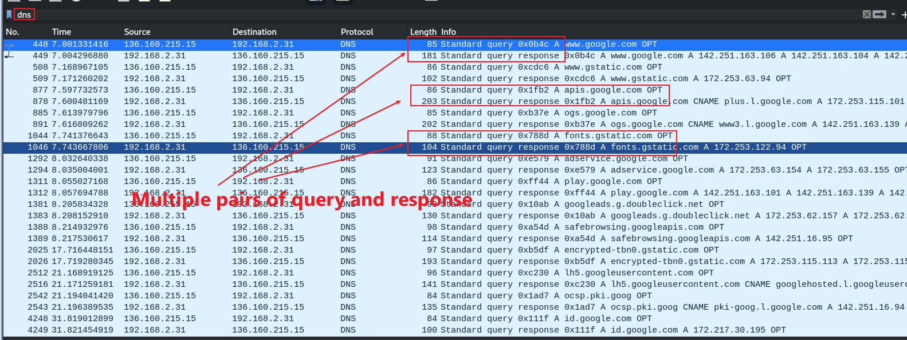
Multiple pairs of DNS query and response because Google results page contains multiple hidden URLs (ads, images)

Slide 22
DNS analysis of Email traffic

Slide 23
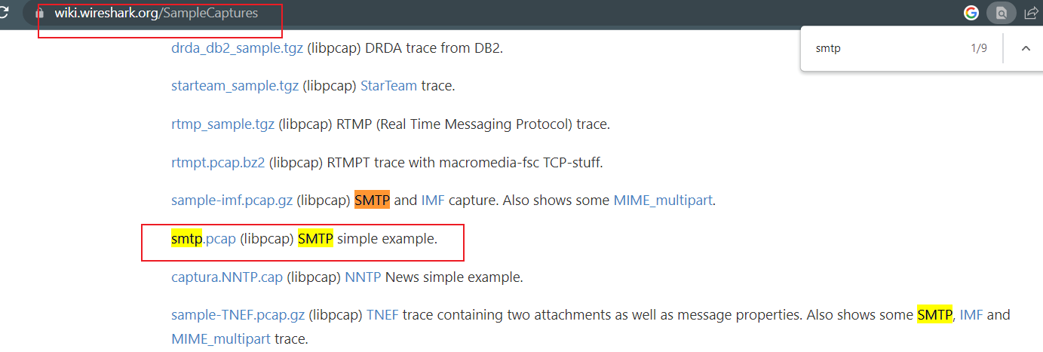
Lab Files
https://wiki.wireshark.org/SampleCaptures

Slide 24
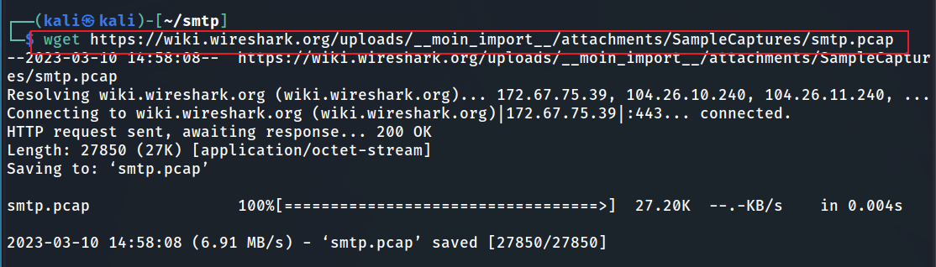
Download smtp.pcap
Notes:
wget https://wiki.wireshark.org/uploads/__moin_import__/attachments/SampleCaptures/smtp.pcap

Slide 25
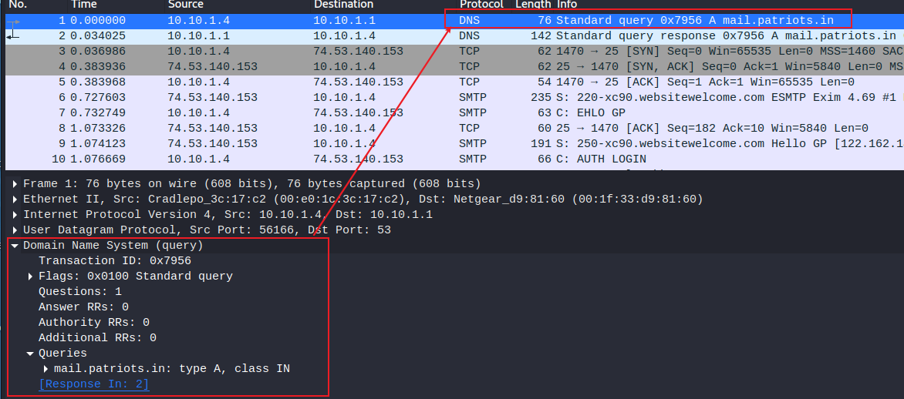





DNS query
Router, please find the IP of mail.patriots.in
Application layer protocol
asking it to return the IPv4 (Type A) address associated with a given domain name, using the Internet namespace (Class IN).

Slide 26
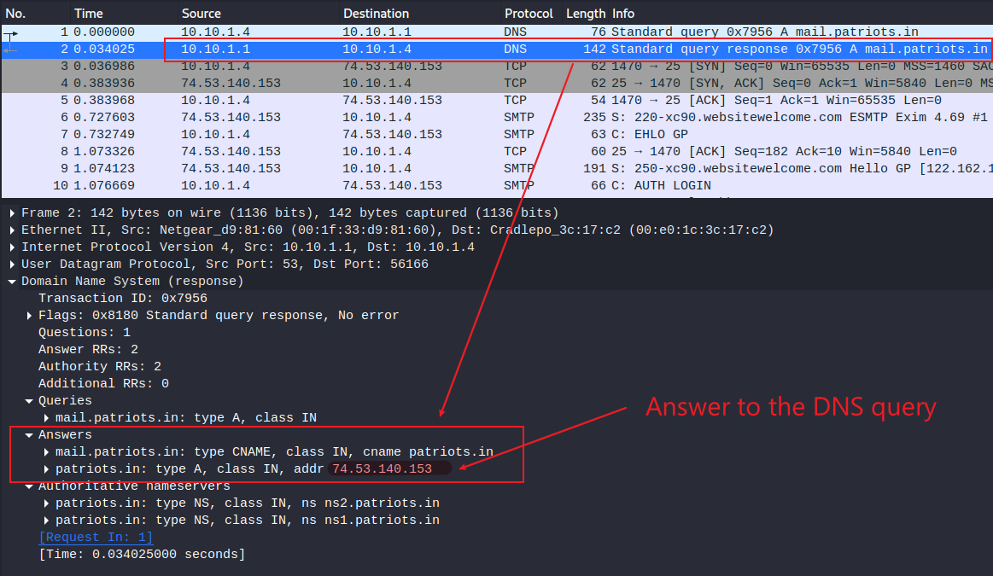
DNS query response

Slide 27
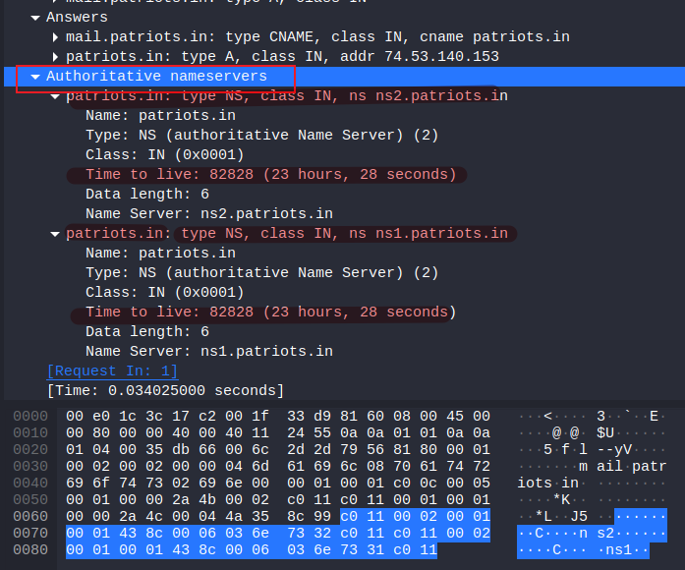
Authoritative nameservers =authoritative DNS servers
Answer from the router DNS caching
The original and official information about a domain name from ns1.patriots.in or ns1.patriots.in.
The DNS entry will expire
Possible DNS attack

Slide 28
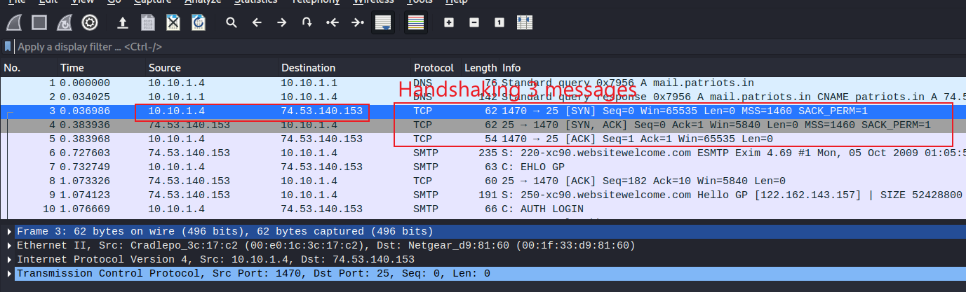
Handshaking (SYN, [SYN, ACK], ACK)

